Slide 1

Al-Farabi Kazakh National University
Higher School of Medicine
THERMODYNAMICS

Slide 2
LEARNING OUTCOMES
As a result of the lesson you will be able to:
Describe the laws of thermodynamics and their application in a biological system;
Explain the dependence of free energy on entropy and enthalpy;
Characterize spontaneous, non-spontaneous processes by thermodynamic parameters;
Describe the thermodynamics of an open system using the example of the human body.
Characterize entropy as an important indicator for living or non-living biological
systems.
Describe the value of the Gibbs free energy for biological systems and on calculated
examples;

Slide 3
Thermodynamics
The science of energy, that concerned with the ways in which energy is stored within a body.
Energy transformations – mostly involve heat and work movements.
Law of conservation of energy:
energy may be converted from one form to another, but the total quantity of energy remains constant.

Slide 4
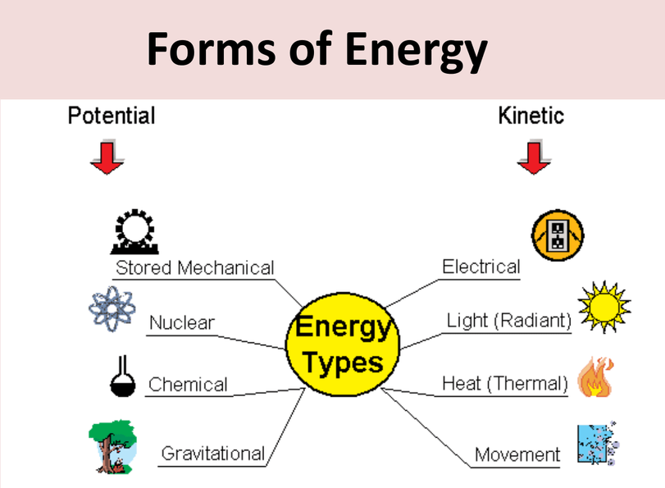
Notes:
https://phet.colorado.edu/sims/html/energy-forms-and-changes/latest/energy-forms-and-changes_en.html

Slide 5
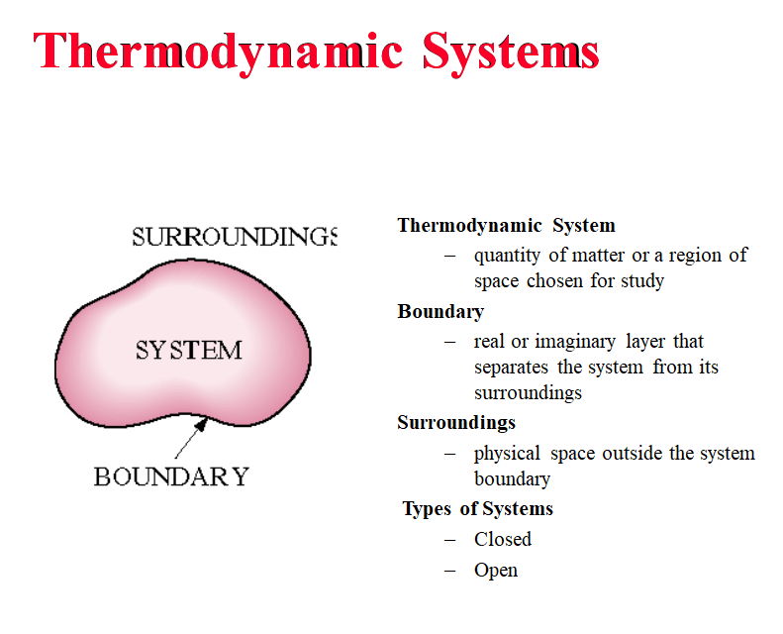

Slide 6
Properties of a system
Properties of a system is a measurable characteristic of a system that is
in equilibrium.
Properties may be intensive or extensive.
Intensive – Are independent of the amount of mass:
e.g: Temperature, Pressure, and Density,
Extensive – varies directly with the mass
e.g: mass, volume, energy, enthalpy

Slide 7
WORK and HEAT
Work – transfer of energy to change height of the weight in surrounding eg: work to run a piston by a gas.
Heat is defined as the energy that flows into or out of a system because of a difference in temperature between the thermodynamic system and its surroundings.
HCl_{(aq)} + NaOH_{(aq)} → NaCl_{(aq)} + H₂O_{(l)} - heat given off.
If heat released to surroundings – exothermic.
If heat absorbed from surroundings – endothermic

Slide 8


Enthalpy
Enthalpy (denoted H) is an extensive property of a substance that
can be used to obtain the heat absorbed or evolved in a chemical reaction.
Enthalpy is a state function. A state function is a property of a system that depends only on its present state, which is determined by variables such as temperature and pressure, and is independent of any previous history of the system.
The enthalpy of reaction equals the heat of reaction at constant pressure.

Slide 9
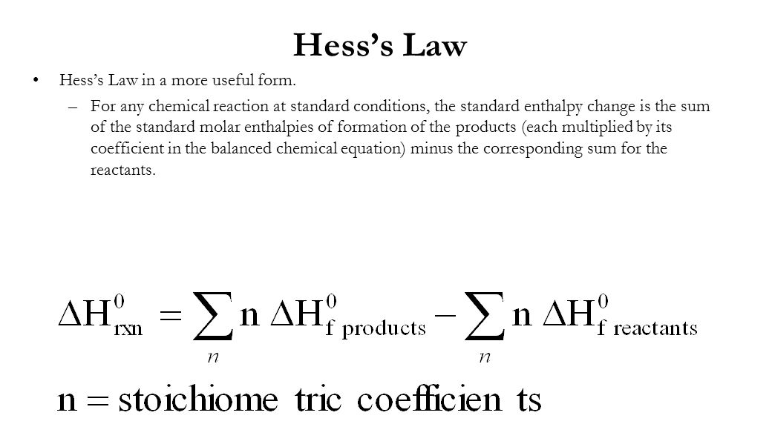

Slide 10

The internal energy, U, is the sum of the kinetic and potential energies of the particles making up the system. The kinetic energy includes the energy of motion of electrons, nuclei, and molecules. The potential energy results from the chemical bonding of atoms and from the attractions between molecules.
Internal energy is a state function. That is, it is a property of a system that depends only on its present state, which is completely determined by variables such as temperature and pressure. Thus, 1 mol of water at 0°C and 1 atm pressure has a definite quantity of energy. When a system changes from one state to another, its internal energy changes from one definite value to another. You can calculate the change in internal energy, ΔU, from the initial value of the internal energy, Ui, and the final value of the internal energy Uf,

Slide 11
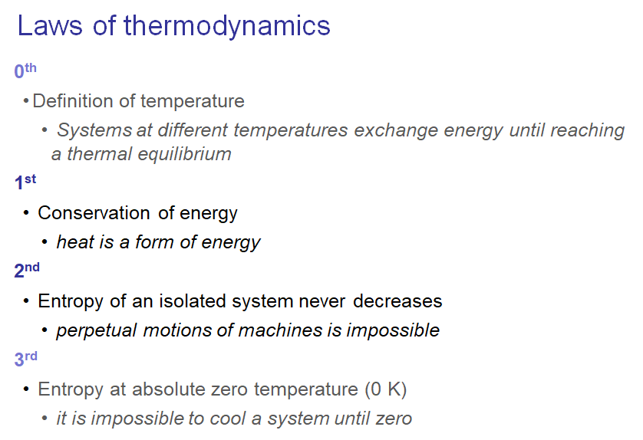

Slide 12
First Law of Thermodynamics
Energy cannot be created or destroyed in chemical reactions
Therefore, the total energy of the universe is a constant
Energy can, however, be converted from one form to another or transferred from a system to the surroundings or vice versa.
UNIVERSE
System – part of world have special interest in…
Surroundings – where we make our observations

Slide 13

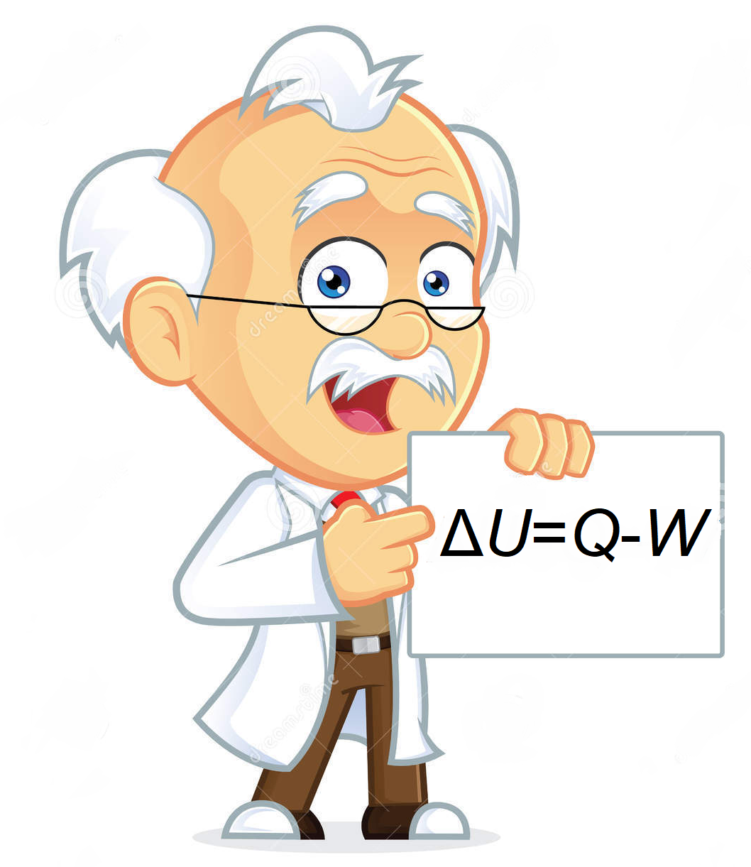
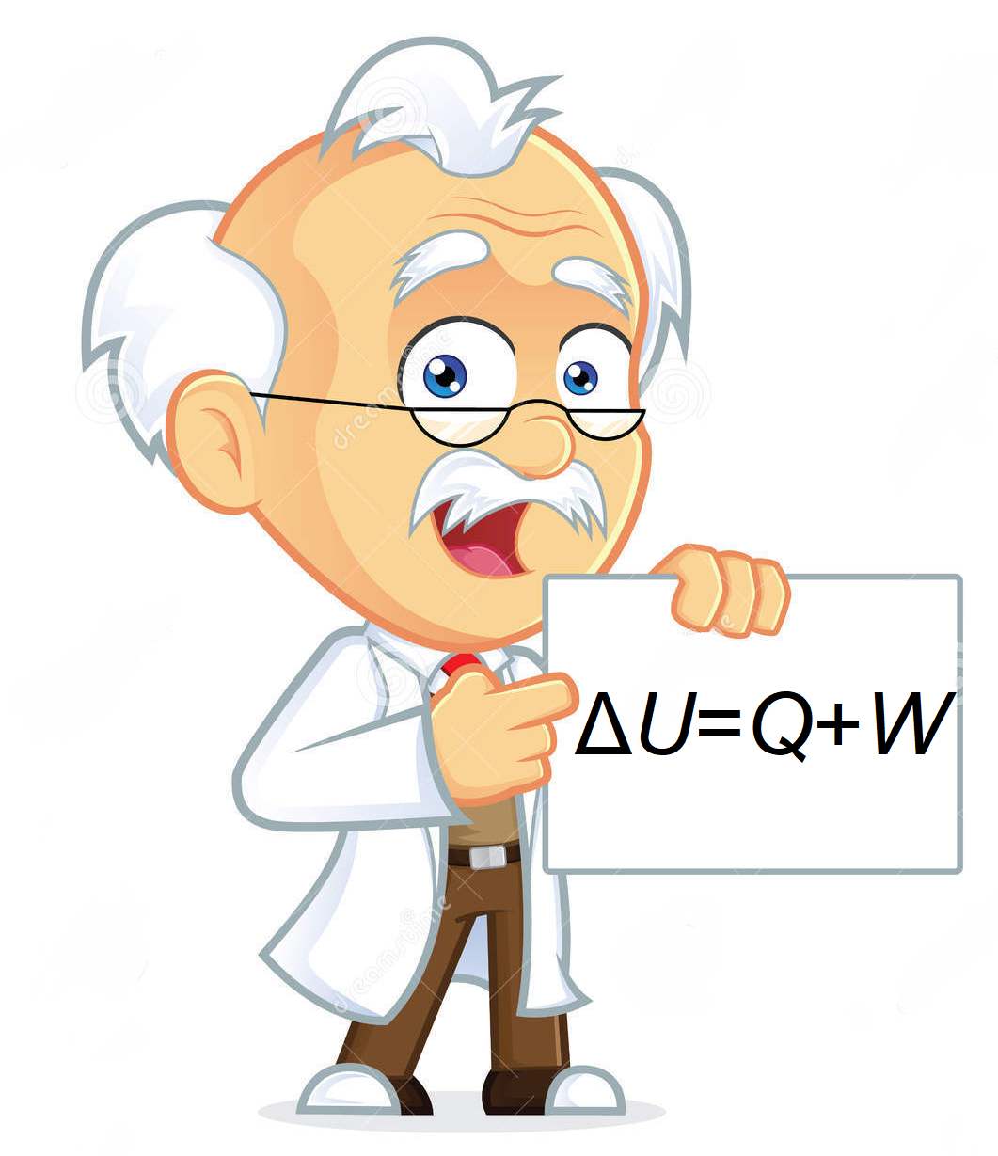
First law of thermodynamics: Left or right or BOTH?

Slide 14
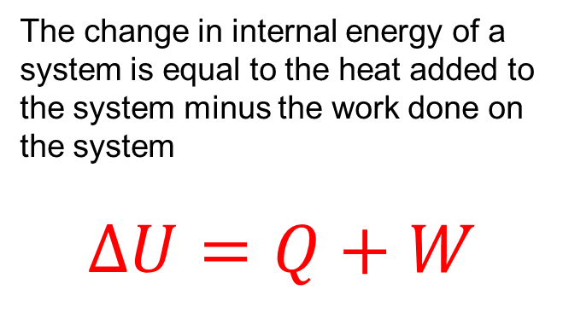
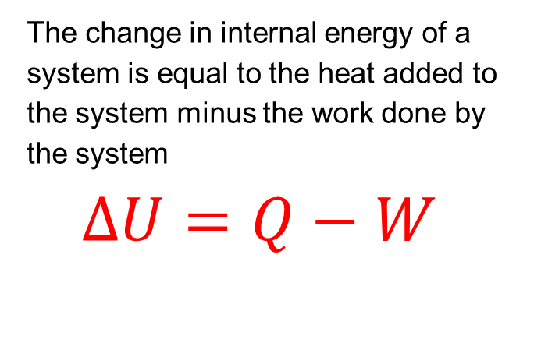
Answer: BOTH
The change in internal energy of a system is equal to the heat added to the system minus the work done by the system
$$∆U=Q−W$$
The change in internal energy of a system is equal to the heat added to the system minus the work done on the system
$$∆U=Q+W$$
Change in internal energy
Heat added to the system
Work done by the system

Slide 15
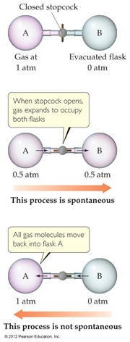
Spontaneous Processes
• Spontaneous processes are those that can proceed without any outside intervention.
• The gas in vessel B will spontaneously effuse into vessel A, but once the gas is in both vessels, it will not spontaneously return to vessel B.

Slide 16
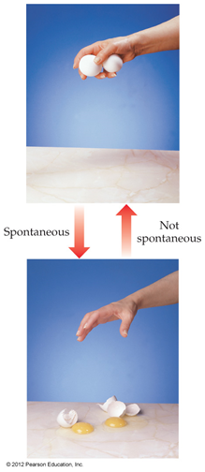
Spontaneous Processes
Processes that are spontaneous in one direction are nonspontaneous in the reverse direction

Slide 17
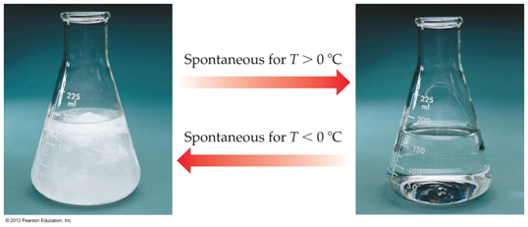
Spontaneous Processes
•Processes that are spontaneous at one temperature may be nonspontaneous at other temperatures.
•Above 0 °C, it is spontaneous for ice to melt.
•Below 0 °C, the reverse process is spontaneous.

Slide 18
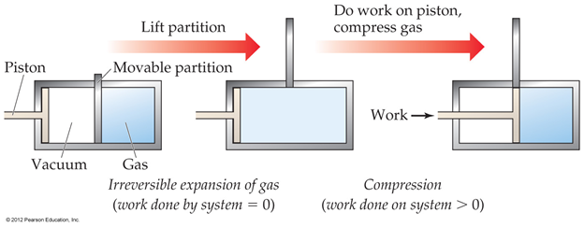
Irreversible Processes
• Irreversible processes cannot be undone by exactly reversing the change to the system.
• Spontaneous processes are irreversible.

Slide 19
Entropy
• Entropy (S) is a term coined by Rudolph Clausius in the 19th century.
• Clausius was convinced of the significance of the ratio of heat delivered and the temperature at which it is delivered,
• Entropy can be thought of as a measure of the randomness of a system.
• It is related to the various modes of motion in molecules.

Slide 20

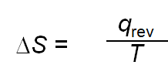
Entropy
• Like total energy, E, and enthalpy, H, entropy is a state function.
• Therefore,
• For a process occurring at constant temperature (an isothermal process), the change in entropy is equal to the heat that would be transferred if the process were reversible divided by the temperature:

Slide 21
Second Law of Thermodynamics
The second law of thermodynamics states that the entropy of the universe increases for spontaneous processes, and the entropy of the universe does not change for reversible processes

Slide 22
Second Law of Thermodynamics
In other words:
For reversible processes:
ΔS_{univ} = ΔS_{system} + ΔS_{surroundings} = 0
For irreversible processes:
ΔS_{univ} = ΔS_{system} + ΔS_{surroundings} > 0
These last truths mean that as a result of all spontaneous processes, the entropy of the universe increases.

Slide 23
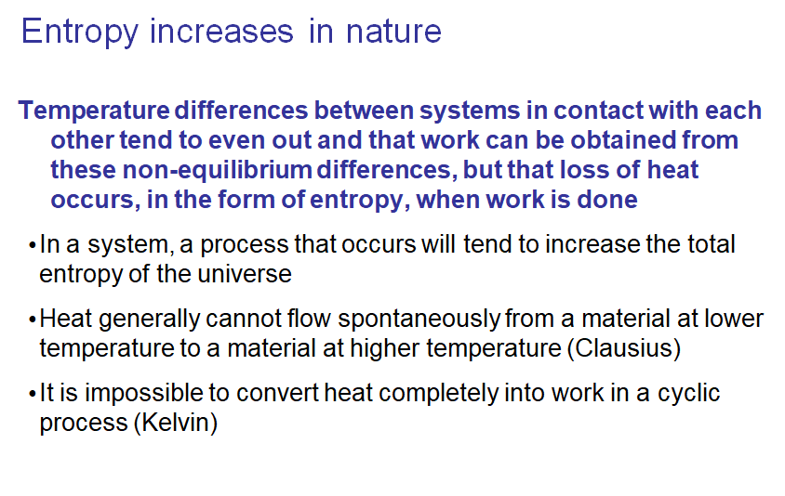

Slide 24
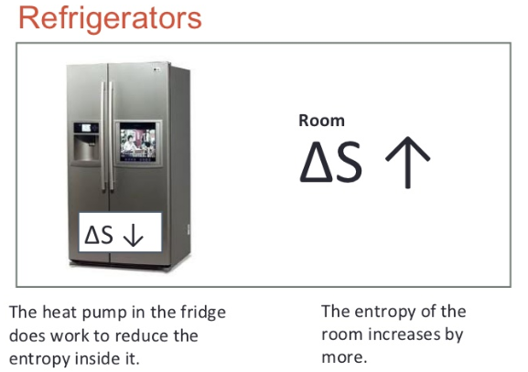

Slide 25
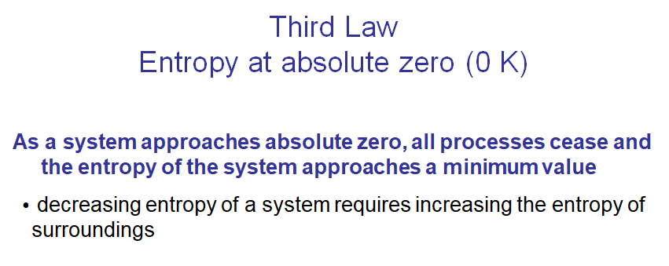

Slide 26
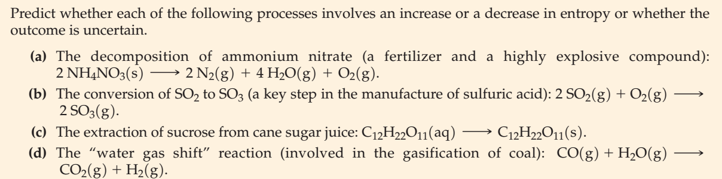
Making Qualitative Predictions of Entropy Changes in Physical and
Chemical Processes

Slide 27
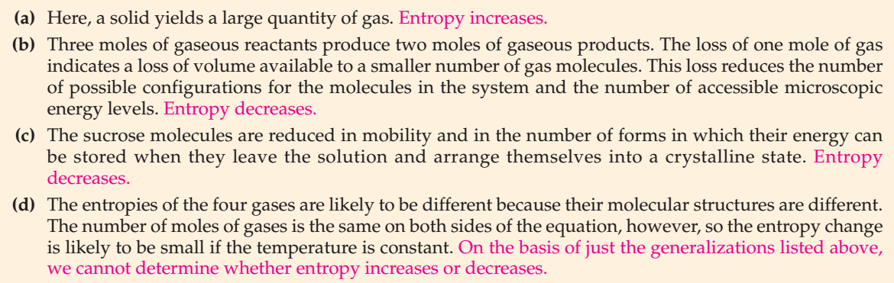
Key

Slide 28
Gibbs Energy Equation
dG = dH - TdS,
where dG is the change in Gibbs energy, dH is the change in enthalpy,
T is the temperature, dS is the change in entropy
* If dG is a negative number, the reaction will be spontaneous.
* If dG is a positive number, the reaction will be nonspontaneous.
* If dG is a zero, the reaction is at equilibrium.

Slide 29
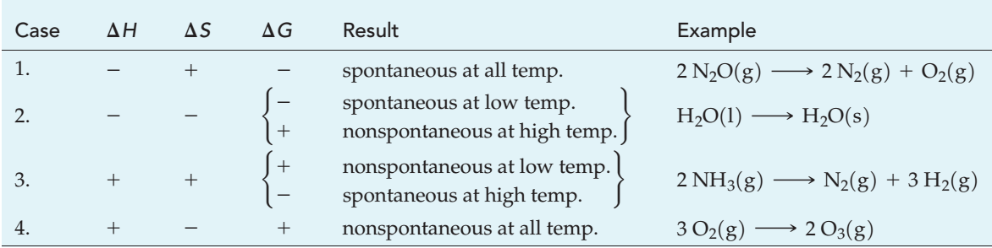
Applying the Criteria for Spontaneous Change:
Δ G = ΔH -TΔS

Slide 30
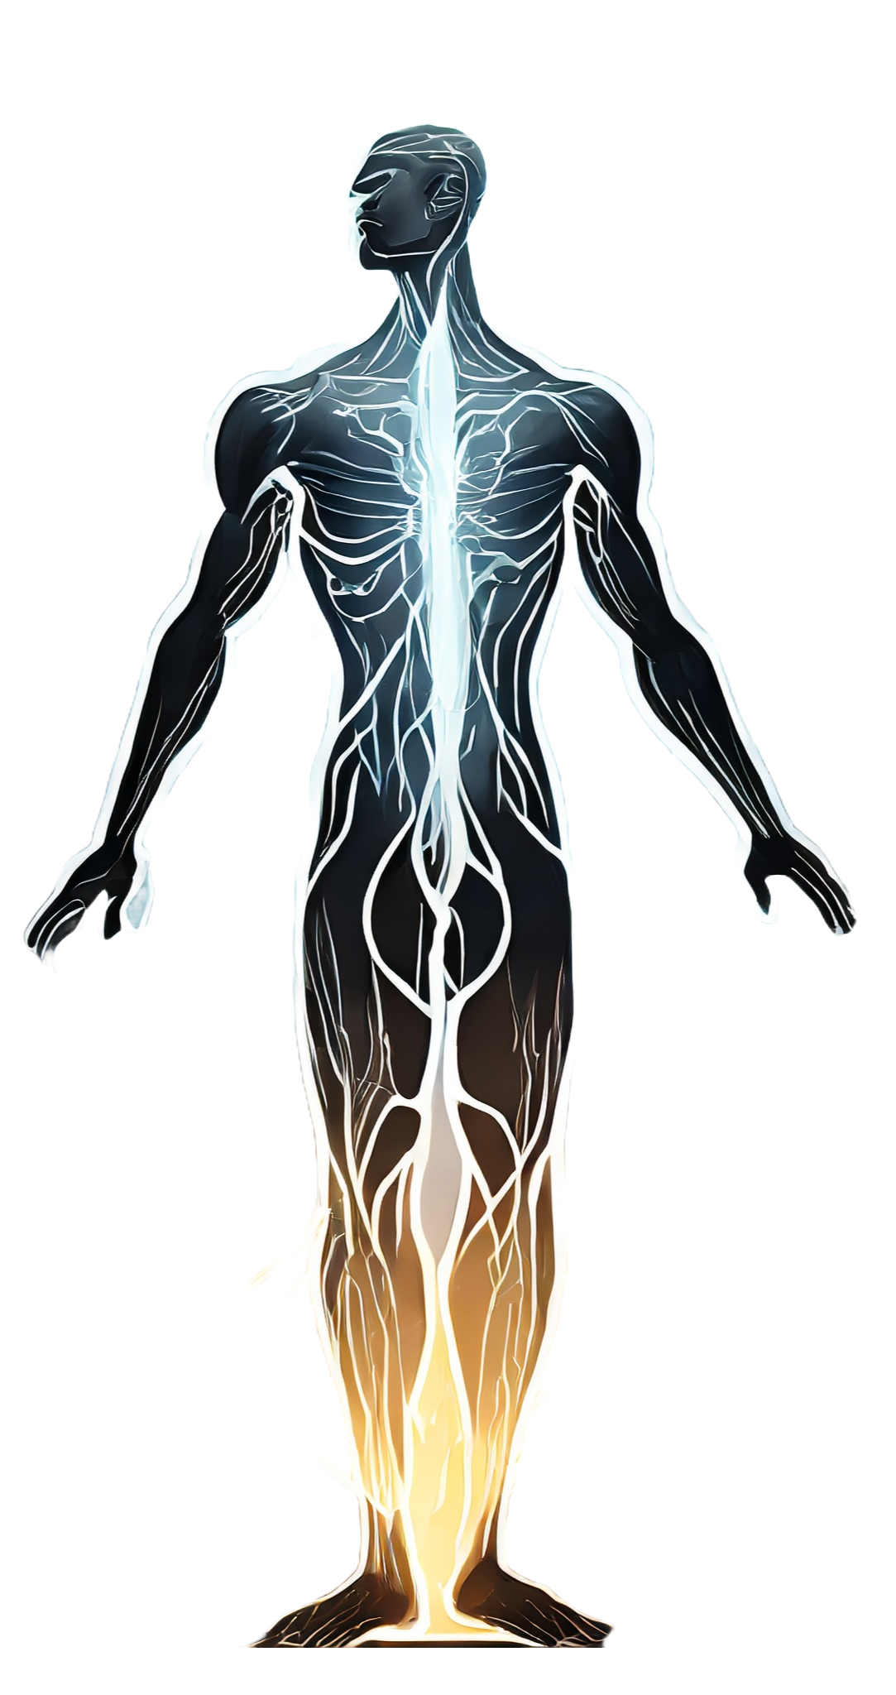
Application in a biological system
Metabolism: The first law of thermodynamics is particularly relevant to metabolic processes in living organisms. Energy from nutrients is used to perform work, maintain structure, and support various cellular functions.
Heat Production: Biological systems generate heat as a byproduct of metabolic reactions. This heat production is consistent with the second law of thermodynamics, as some energy is always lost as heat.
Energy Transfer: The flow of energy within ecosystems, from the sun to producers (plants), and through various trophic levels (consumers), can be explained by the laws of thermodynamics. Energy is transferred and transformed as it moves through the food chain.

Slide 31
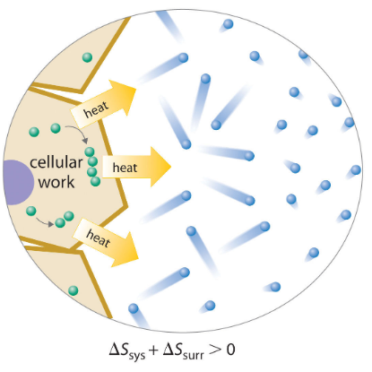
A CELL AND ITS SURROUNDINGS
Because cells are open systems, they cannot be described using the concepts of classical thermodynamics. A cell releases some of the energy that it obtains from its environment as heat that is transferred to its surroundings, there by resulting in an increase in. As long as ΔSsurr is positive and greater than ΔSsys, the entropy of the universe increases, so the second law of thermodynamics is not violated.

Slide 32
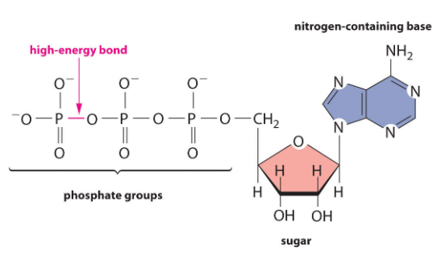
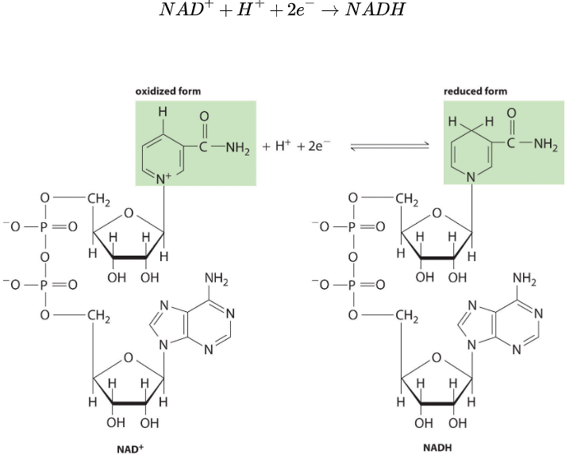
THE ROLE OF NADH AND ATP IN METABOLISM

Slide 33
This electron carrier is used by biological systems to transfer electrons from one species to another. The oxidized form (NAD) is reduced to NADH by energy-rich nutrients such as glucose, and the reduced form (NADH), is then oxidized to NAD by O2 during respiration.
The high-energy phosphoric acid anhydride bond in ATP stores energy released during the oxidation of nutrients. Hydrolysis of the high-energy bond in ATP releases energy, forming adenosine diphosphate (ADP) and phosphate

Slide 34
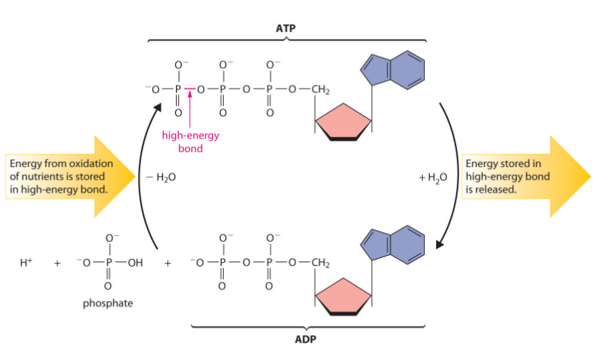

The chemical equation that corresponds to the hydrolysis of ATP to ADP and phosphate is as follows:
During oxidation, a fraction of the energy obtained from the oxidation of the nutrient is stored as ATP. The phosphoric acid anhydride bonds in ATP can then be hydrolyzed by water, releasing energy and forming ADP (adenosine diphosphate).It is through this sequence of reactions that energy from the oxidation of nutrients is made available to cells.

Slide 35
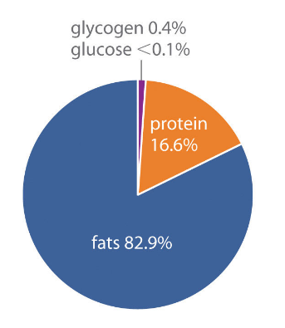
ENERGY STORAGE IN CELLS
Three primary means are as sugars, proteins, and fats. A typical 70 kg adult human has about 170 kJ of energy in the form of glucose circulating in the blood, about 2600 kJ of energy stored in the muscles and liver as glycogen (a polymeric form of glucose), about 100,000 kJ stored in the form of protein (primarily muscle tissue), and almost 500,000 kJ in the form of fats. Thus fats constitute by far the greatest energy reserve, while accounting for only about 12 kg of the 70 kg body mass.
Notes:
https://phet.colorado.edu/sims/html/energy-forms-and-changes/latest/energy-forms-and-changes_en.html

Slide 36
We’ve studied today
Describe the laws of thermodynamics and their application in a biological system;
Explain the dependence of free energy on entropy and enthalpy;
Characterize spontaneous, non-spontaneous processes by thermodynamic parameters;
Describe the thermodynamics of an open system using the example of the human body.
Characterize entropy as an important indicator for living or non-living biological
systems.
Describe the value of the Gibbs free energy for biological systems and on calculated
examples;

